Slide 1
What are we going to see in this session?
Small scale code structure
Medium scale code structure
Large scale code structure
Sample codes for other service provider
Links to learn

Slide 2
Small scale infrastructure
We can maintain very basic code structure in small-scale infrastructure.
Minimum files required are.
main.tf [provider & resource]
vars.tf [variables declared]
terraform.tfvars [variables & credentials defined]
output.tf [optional]
backend.tf [optional]

Slide 3
Medium scale infrastructure
Medium scale infrastructure are well structured with modules
Minimum files required are.
Modules
main.tf
output.tf
vars.tf
Prod
main.tf
Staging
main.tf

Slide 4
Large scale infrastructure
Pretty much same structure of medium scale is followed, but I have seen many companies used workspace to classify the state files according to environment.
Minimum files required are.
Modules
main.tf
output.tf
vars.tf
Prod
main.tf
Staging
main.tf
terraform.state

Slide 5
Sample codes for other service provider
Vmware
Azure
GCP

Slide 6
Links
AWS_docs
Azure_docs
GCP_docs
VMware_docs

Slide 7
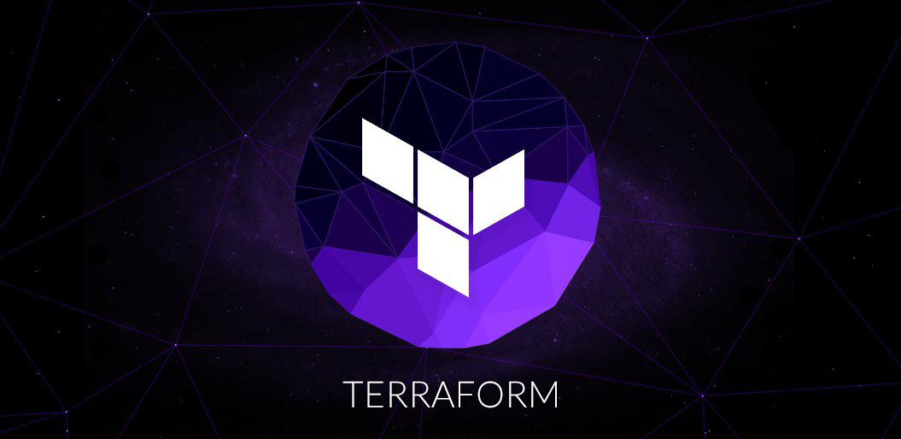
End of this topic !
Any questions?

Slide 8

Thanks!
You can find me at:
vijayprabhu.cs@gmail.com
+91-8056375375
LinkedIn
Contents @ Git-Hub

